Slide 1


INDIAN INSTITUTE OF TECHNOLOGY, MADRAS
BUSINESS DATA MANAGEMENT
MAXIMIZING THE SALES OF AN AUTOMOBILE STORE
PROJECT PRESENTATION
PRESENTED BY:
ANSHIKA TIWARI
22f1000493@ds.study.iitm.ac.in

Slide 2
TABLE OF CONTENT
01
04
RESULTS AND FINDINGS
ABOUT THE BUSINESS
02
DATA ANALYSIS PROCESS
05
RECOMMENDATIONS
03
PROBLEMS FACED

Slide 3
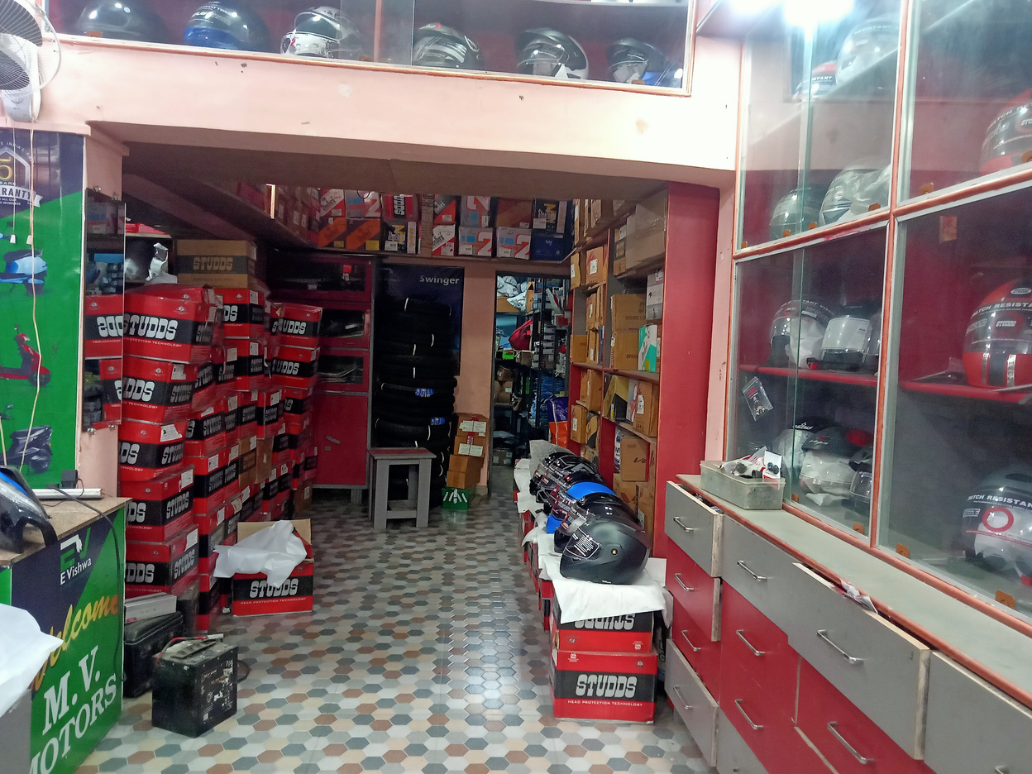
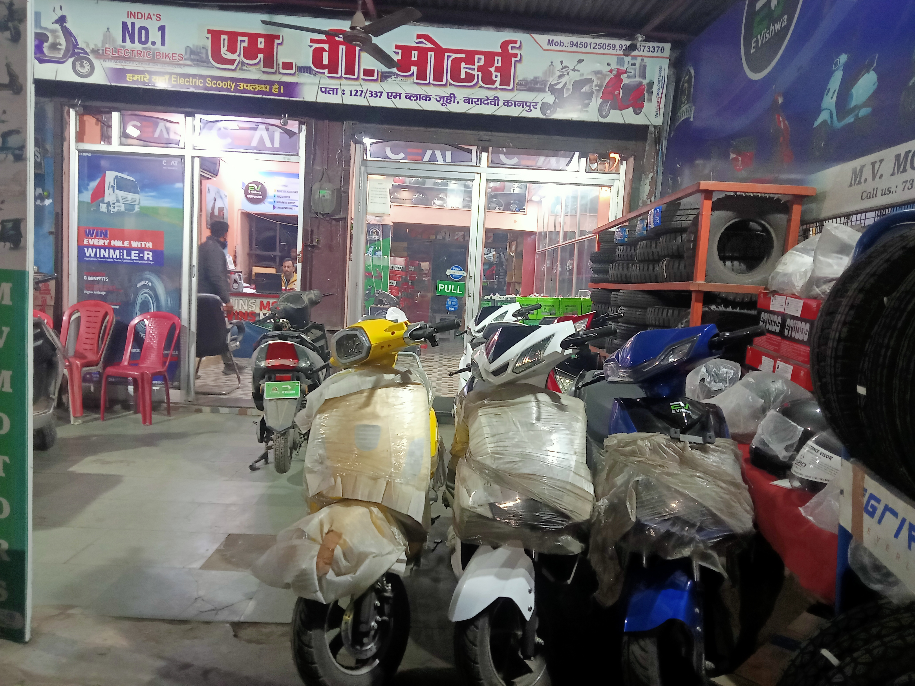
ABOUT THE BUSINESS
M V Motors is a local automobile store in Kanpur. It is a B2C business established in the year 2020.
The store deals in electric scooters and automobile spare parts. It also provides repairing services to the customers.
The business is owned by Mr. Shubham Nigam.
The business employs 3-4 workers which includes mechanics and cleaning staff.
The data collected from the business was sales and purchase data from October 2023 to December 2023

Slide 4
ANALYSIS PROCESS
DATA ANALYSIS
RESULTS AND RECOMMENDATIONS
DATA CLEANING
DATA ANALYSIS WAS PERFORMED USING MS EXCEL.
VARIOUS PIVOT CHARTS AND PIVOT TABLES WERE MADE DURING ANALYSIS PROCESS
AFTER THE VISUALIZATION AND ANALYSIS OF THE DATA, DIFFERENT RESULTS WERE FOUND.
RECOMMENDATION WERE GIVEN BASED ON INTERPRETATIONS OF THOSE RESULTS.
THE DATA WAS CLEANED AND THE MISSING DATA WAS IMPUTED USING APPROPRIATE METHODS
2
4
6
1
3
5
DATA COLLECTION
DATA CLASSIFICATION
DATA VISUALIZATION
THE DATA WAS COLLECTED FROM THE BUSINNESS AFTER A FEW MEETINGS WITH THE OWNER.
THE DATA COLLECTED WAS SALES AND PURCHASE DATA OF 3 MONTHS
AFTER CLEANING THE DATA AND IMPUTING MISSING VALUES, SOME NEW COLUMNS WERE ADDED TO MAKE THE ANALYSIS PROCESS EASIER.
DATA VISUALIZATION TOOLS WERE USED TO SEE THE TRENDS IN THE DATA. CHARTS LIKE BAR CHARTS AND PARETO CHARTS WERE USED FOR DATA VISUALIZATION

Slide 5
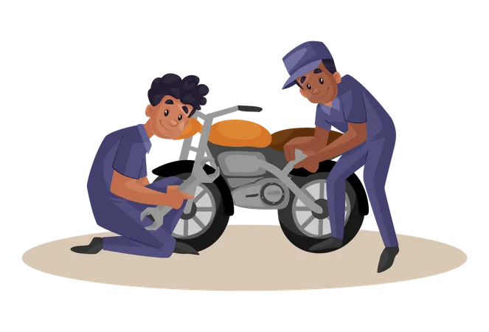



PROBLEMS FACED
Low Sales of EV Scooters
Low revenue generated through repairing services
Market Competition
Overstocking
The sales of Electric scooters was not satisfactory. During an interaction with the owner, he told me that people are unaware about the advantages of EV scooters over conventional scooters.
Another problem faced by the business was that the revenue generated through the repairing services was decreasing.
Market competition was also a big issue faced by the business as there were many other automobile stores in that area, which was affecting the store's sales.
Overstocking was a major problem faced by the business. The purchase of some products was way more than their sale.

Slide 6
RESULTS AND FINDINGS
ANALYSIS OF ELECTRIC SCOOTER’S SALE
CATEGORY WISE ANALYSIS OF SPARE PARTS
The maximum sales of EV scooters was made in the month of November, during the festive season,
which was Rs.225000 .
The most revenue generating category of spare parts is “Tyres”, which generated revenue of Rs.103898.01 from October 2023 to December 2023.

Slide 7

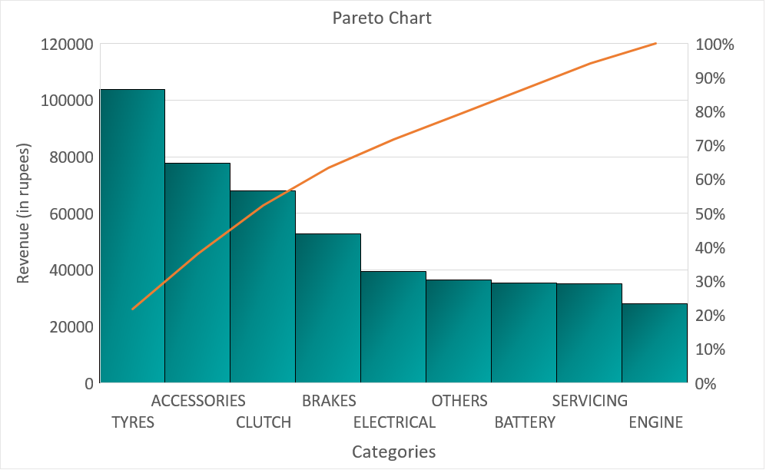
RESULTS AND FINDINGS
DAILY REVENUE ANALYSIS
PARETO ANALYSIS
Time series graph was used to analyze the daily revenue generated through automobile spare parts.
The maximum revenue generated was on 9th November 2023 of Rs. 21110.86.
Pareto analysis was also performed to find out the categories which contribute the most to revenue.
After analyzing, it was found that Tyres, Accessories and Clutch were 3 main revenue generating categories.

Slide 8
RESULTS AND FINDINGS
ANALYSIS OF DIFFERENT ACCESSORIES SOLD
PRODUCT WISE ANALYSIS
The most revenue generating product in “Accessories” category is Helmet, which generated revenue of Rs.30651.66 from October 2023 to December 2023.
.
The most revenue generating product is Tyre, which generates total revenue of Rs. 48123.36 in 3 months.

Slide 9
RECOMMENDATION
03
Online Presence
SOLUTIONS OF THE PROBLEMS
They should also start promoting their business online, this will help them in standing out in the competitive market
01
Giving Offers To The Customers
The sales of EV scooters was the most during the festive season. To increase the sales, the shop can give different offers to the customers on the purchase of scooters.
Example- Free Helmet on purchase of scooter.
04
Employing new staff
They should try to replace the old staff by new and more skilled workers. It is also recommended that they hire a person who could supervise and manage the store properly as the owner may not be available every day.
02
Door-Step Servicing
05
Using more revenue generating and overstocked products
They should start providing doorstep services to their customers by sending their staff to the customer’s place.
They should try selling and using more revenue generating and overstocked parts during repairing as well to increase the sales of these revenue generating items.

Slide 10
THANK YOU
FOR YOUR NICE ATTENTION

